Slide 1
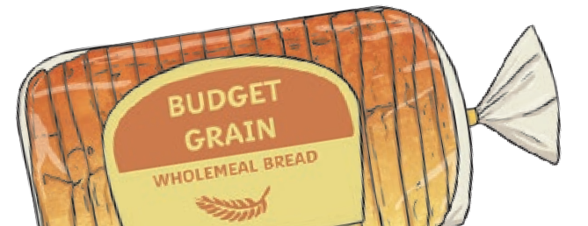
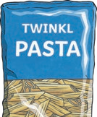
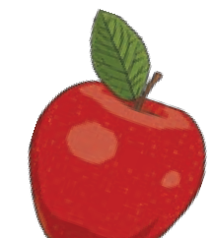

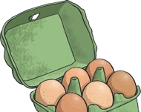
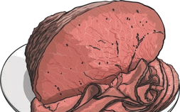
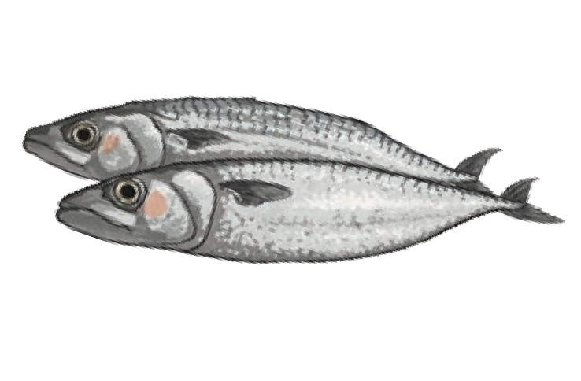
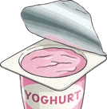
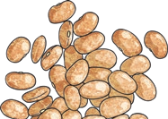
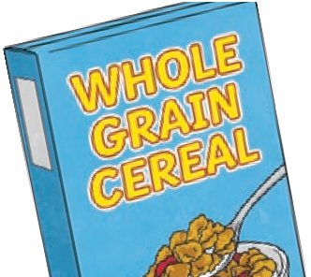
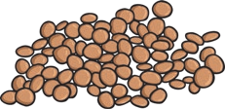
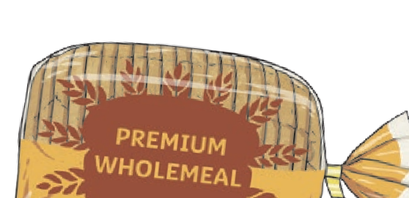
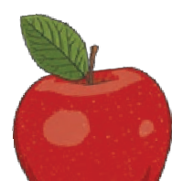
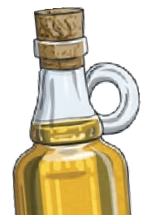
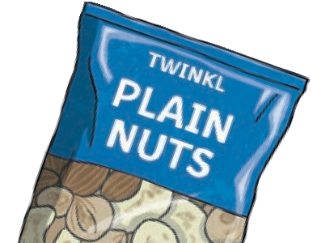

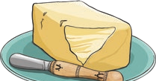
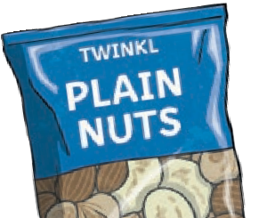
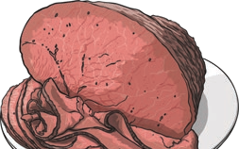
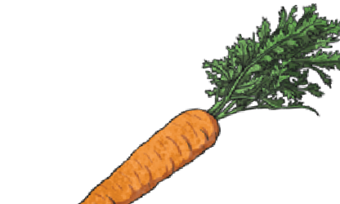
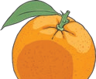
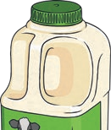
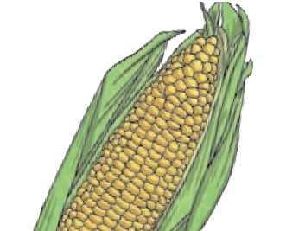
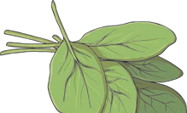

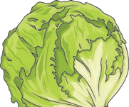
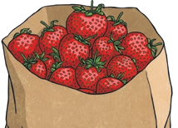
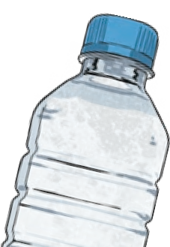
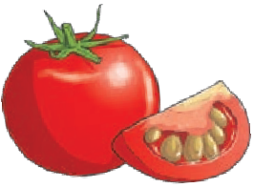

Animals Including Humans
Key Vocabulary
healthy | in a good physical and mental condition
nutrients | substances that living things need to stay alive and healthy
energy | strength to be able to move and grow
saturated fats | types of fats, considered to be less healthy, that should only be eaten in small amounts
unsaturated fats | fats that give you energy, vitamins and minerals
Nutrient | Found in... (examples) | What it does/they do
carbohydrates |  | provide energy
protein |  | helps growth and repair
fibre |  | helps you to digest the food that you have eaten
fats |  | provide energy
vitamins |  | keep you healthy
minerals |  | keep you healthy
water |  | moves nutrients around your body and helps to get rid of waste
Living things need food to grow and to be strong and healthy.
Plants can make their own food, but animals cannot.
To stay healthy, humans need to exercise, eat a healthy diet and be hygienic.
Animals, including humans, need food, water and air to stay alive.
Year 3/4 Spring Term 1 Year B Science Knowledge Organiser St Mary’s Catholic Primary School

Slide 2
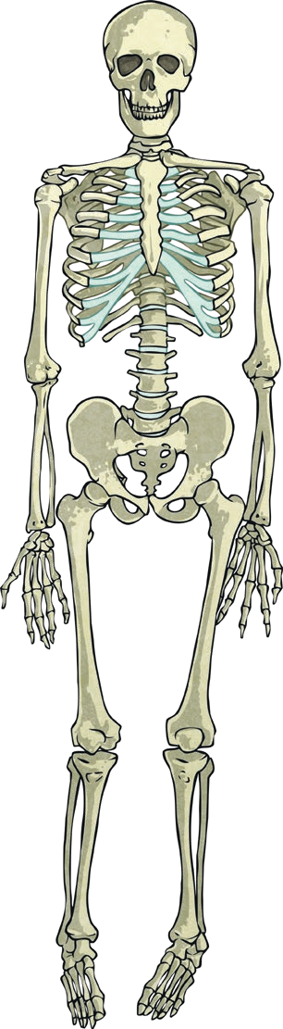
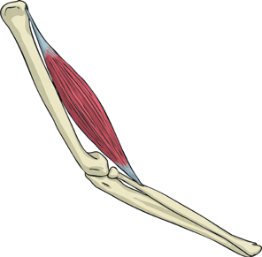
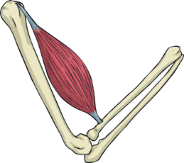
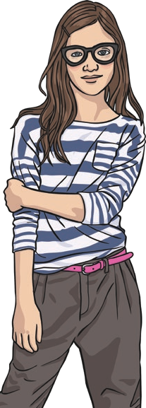
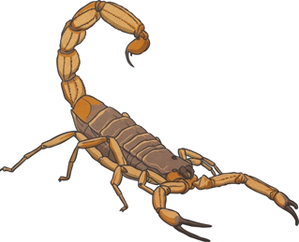
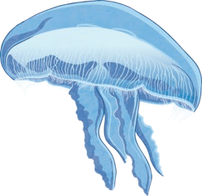
Animals Including Humans
Key Vocabulary
vertebrate | animals with backbones
invertebrate | animals without backbones
muscles | soft tissues in the body that contract and relax to cause movement
tendons | cords that join muscles to bones
joints | areas where two or more bones are fitted together
Skeletons do three important jobs:
protect organs inside the body;
allow movement;
support the body and stop it
from falling on the floor.
skull
Skeletal muscles work in pairs to move the bones they are attached to by taking turns to contract (get shorter) and relax (get longer).
clavicle
scapula
ribcage
vertebral column
humerus
vertebrate endoskeleton | – a skeleton on the inside of the body that supports and protects it | contract |  | relax
invertebrate |  |  |  | a skeleton made up of a fluid-filled compartment in the body called a coelom, mainly found in soft- bodied animals
exoskeleton – a skeleton on the outside of the body that supports and protects it |  |  | hydrostatic skeleton –
ulna
radius
pelvis
femur
tibia
fibula
Year 3/4 Spring Term 1 Year B Science Knowledge Organiser St Mary’s Catholic Primary School

